Slide 1


Optics Laboratory
2nd Grade - 1st Semester
2018/2019
Instructors
Assist. Prof. Dr. Sabah Ibrahim
Assist. Lect. Muhanned Jamal
Assist. Lect. Najwa Ibrahim

Slide 2
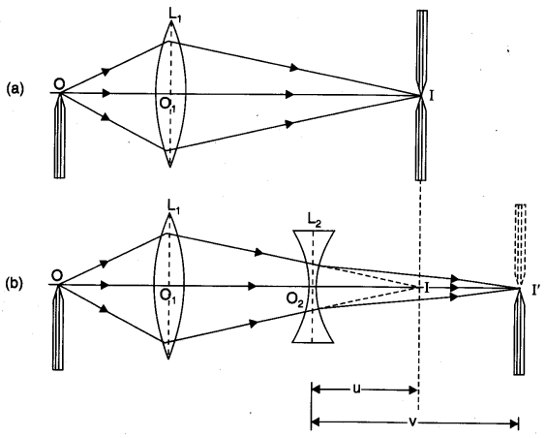
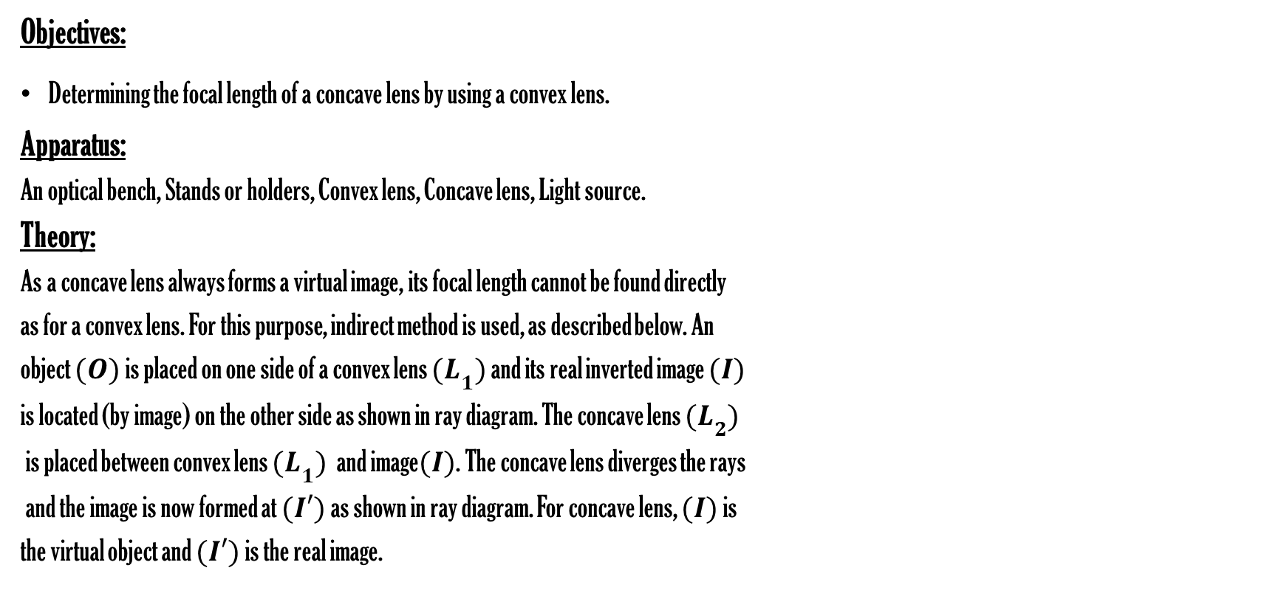
Experiment Four
Determining Focal Length of Concave Lens Using a Convex Lens.
Objectives:
Determining the focal length of a concave lens by using a convex lens.
Apparatus:
An optical bench, Stands or holders, Convex lens, Concave lens, Light source.
Theory:
As a concave lens always forms a virtual image, its focal length cannot be found directly
as for a convex lens. For this purpose, indirect method is used, as described below. An
object $(O)$ is placed on one side of a convex lens ${(L}_{1})$ and its real inverted image $(I)$
is located (by image) on the other side as shown in ray diagram. The concave lens ${(L}_{2})$
is placed between convex lens ${(L}_{1})$ and image$(I)$. The concave lens diverges the rays
and the image is now formed at $(I′)$ as shown in ray diagram. For concave lens, $(I)$ is
the virtual object and $(I′)$ is the real image.

